Slide 1
Purchase Pattern Analysis (MBA)
Title: Market Basket Analysis: Purchase Pattern Insights
Subtitle: Project Summary and Business Recommendations
Presented by: Shilpa Mane
Date: 09-06-2025

Slide 2
Project Overview
Objective: Analyze retail transactions to discover purchasing patterns
Tools Used: Power BI, Python (Apriori), Excel
Dataset: Retail sales (BillNo, ItemName, Quantity, Price,Present_Date, Country, CustomerID)
Duration: Four-Week Roadmap

Slide 3
Data Cleaning Steps
Removed null or duplicate records
Standardized product names (CleanItem)
Filtered out single-item transactions for co-occurrence logic
Created derived tables for product pairing

Slide 4
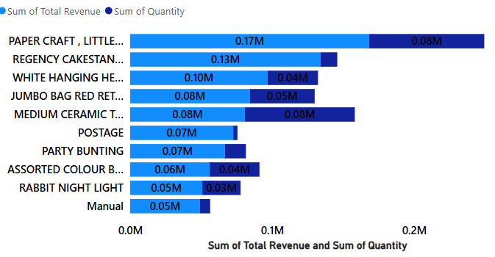
Exploratory Data Analysis
Total Transactions: 18.16k
Total Unique Products:3846
Most Purchased Products (Top 10)

Slide 5
Apriori Algorithm – Overview
Purpose: Discover frequent itemsets & association rules
Key Terms:
Support
Confidence
Lift
Method: Implemented Apriori in Python

Slide 6
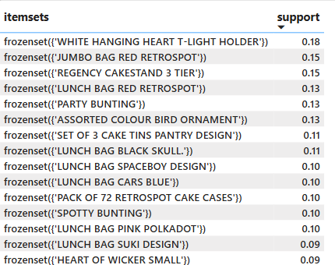
Frequent Itemsets
Top itemsets found:

Slide 7
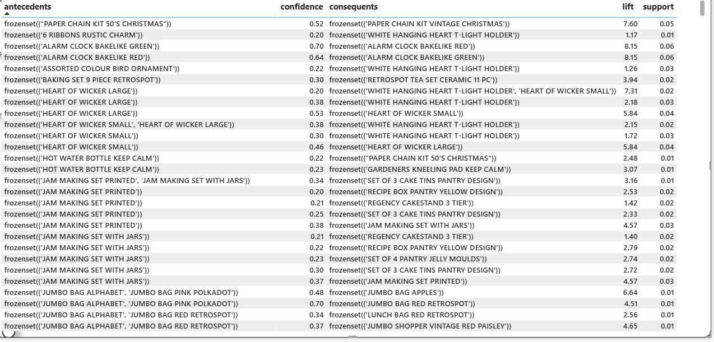
Association Rules

Slide 8
Visual Dashboard
Snapshot of Power BI visualizations:
Product co-occurrence heatmap
Frequent items chart
Association rule visual (network graph)

Slide 9
Business Recommendations
Implement bundling strategies for top product pairs
Improve placement for frequently co-purchased products
Launch targeted promotions using high-lift associations
Use insights for optimizing stock and warehouse planning

Slide 10
Final Deliverables
✅ Cleaned Dataset
✅ Apriori Output
✅ Power BI Dashboard
✅ Network Visual showing product relationships
✅ Insights & Recommendations Report
✅ This Presentation

Slide 11
Thank You!

